Slide 1

Human Computer Interaction
PSIT404a
Unit 1 chapter 1
The Interaction

Slide 2
Introduction of Interaction
Interaction models help us to understand what is going on in the interaction between user and system. They address the translations between what the user wants and what the system does.
Ergonomics looks at the physical characteristics of the interaction and how these influence its effectiveness.
The dialog between user and system is influenced by the style of the interface.
The interaction takes place within a social and organizational context that affects both user and system.

Slide 3
Topic 1.1.1 Models of interaction

Slide 4
Models of interaction (Terms of Interaction)
Domain
Tasks
Goal
Task analysis
System
User
Task language
Core language

Slide 5
Models of interaction (Execution Evaluation cycle)
Establishing the goal.
Forming the intention.
Specifying the action
sequence.
Executing the action.
Perceiving the system
state.
Interpreting the system state.
Evaluating the system state with respect to the goals and intentions
goal
execution
evaluation
system

Slide 6
Human errors
slip
understand system and goal correct formulation of action incorrect action
mistake
may not even have right goal!
Fixing things?
slip – better interface design
mistake – better understanding of system

Slide 7
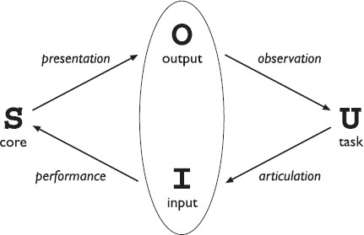
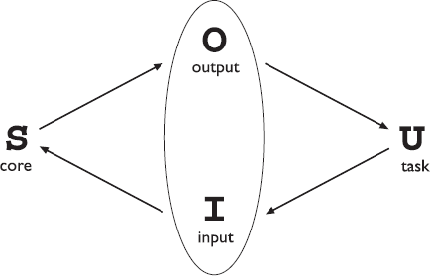
Models of interaction (The interaction framework)
The general interaction framework
Translations between components

Slide 8

Design Focus

Slide 9

Video recorder
Programming a VCR from a remote control
Ineffective interaction
Keys pressed in wrong order
remote control lacks the ability to select channels
presentation problem
observational error

Slide 10
Topic 1.1.2 Frameworks and HCI

Slide 11
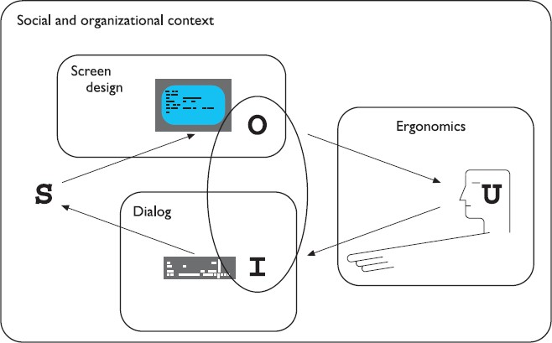
Frameworks and HCI
Dialog design and interface styles can be placed particularly along the
input branch of the framework.
Presentation and screen design relates to the output branch of the framework.

Slide 12

Topic 1.1.3 Ergonomics

Slide 13

The study of the:
physical characteristics of the interaction: how the controls are designed
The physical environment in which the interaction takes place,
The layout and physical qualities of the screen.
Ergonomics

Slide 14
Ergonomics (Arrangement of controls and displays)
Sets of controls and parts of the display should be grouped
logically to allow rapid access by the user.
This may not seem so important when we are considering a single user of a spreadsheet on a PC, but it becomes vital when we turn to safety-critical applications such as plant control, aviation and air traffic control.
functional controls and displays are organized so that those that are functionally related are placed together;
sequential controls and displays are organized to reflect the order of their use in a typical interaction (this may be especially appropriate in domains where a particular task sequence is enforced, such as aviation);
frequency controls and displays are organized according to how frequently they are used, with the most commonly used controls being the most easily accessible.

Slide 15
Ergonomics (The physical environment of the interaction)
As well as addressing physical issues in the layout and arrangement of the machine
interface, ergonomics is concerned with the design of the work environment itself.
Where will the system be used?
By whom will it be used?
Will users be sitting, standing or moving about?
Following are the considerations:
Size of the users
Seating should provide back support.
Stand, the user should have room to move around in order to reach all the controls.

Slide 16
Safety risks of poorly designed safety-critical systems (aircraft crashing, nuclear plant leaks and worse), there are a number of factors that may affect the use of more general computers.
Ergonomics (Health issues)
Physical position
Temperature
Lighting
Noise
Time

Slide 17
Ergonomics (The use of color)
Blue should not be used to display critical information.
Red, green and yellow are colors frequently associated with stop, go and standby respectively. Therefore, red may be used to indicate emergency and alarms; green, normal activity; and yellow, standby and auxiliary function.
Awareness of the cultural associations of color is particularly important in designing systems and websites for a global market.

Slide 18

Ergonomics (Ergonomics and HCI)
Contribution to HCI is in determining constraints on the way we design systems and suggesting detailed and specific guidelines and standards.
Ergonomic factors are in general well established and understood and are therefore used as the basis for standardizing hardware designs.

Slide 19
Topic 1.1.4 Interaction styles

Slide 20

Interaction Styles
COMMAND LINE INTERFACE
MENUS
NATURAL LANGUAGE
QUESTION/ANSWER AND QUERY DIALOG
FORM-FILLS AND SPREADSHEETS
WIMP
POINT AND CLICK
THREE- DIMENSIONAL INTERFACES.

Slide 21

Interaction Styles (Command line interface)
It provides a means of expressing instructions to the computer directly, using function
keys, single characters, abbreviations or whole-word commands.
In some systems the command line is the only way of communicating with the system, especially for remote access using telnet.
Unfortunately, commands are often obscure and vary across systems, causing confusion to the user and increasing the overhead of learning.

Slide 22
Interaction Styles (Menus)
Often menus are hierarchically ordered and the option required is not available at the top layer of the hierarchy.
Text
Graphical

Slide 23
Interaction Styles (Natural language)
Language is ambiguous at a number of levels.
For example, the word ‘pitch’ may refer to a sports field, a throw, a waterproofing
substance or even, colloquially, a territory.
The use of natural language in restricted domains is relatively successful, but it is debatable whether this can really be called natural language.
The user still has to learn which phrases the computer understands and may become frustrated if too much is expected.

Slide 24

Interaction Styles (Question/answer and query dialog)
The user is asked a series of questions (mainly with yes/no responses, multiple choice, or
codes) and so is led through the interaction step by step.
These interfaces are easy to learn and use, but are limited in functionality and power. As such, they are appropriate for restricted domains (particularly information systems) and for novice or casual users.
Query languages, on the other hand, are used to construct queries to retrieve information from a database.
The effective use of query languages requires some experience.
A specialized example is the web search engine.

Slide 25

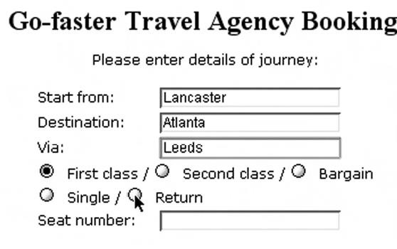
Interaction Styles (Form-fills and spreadsheets)
Most form-filling interfaces allow easy movement around the form and allow some fields to be left blank.
Spreadsheets are a sophisticated variation of form filling. The spreadsheet comprises a grid of cells, each of which can contain a value or a formula.
Spreadsheets are an attractive medium for interaction: the user is free to manipulate values at will and the distinction between input and output is blurred, making the interface more flexible and natural.

Slide 26
Interaction Styles (WIMP)
Windows, Icons, Menus, Pointers
Examples of WIMP interfaces include Microsoft Windows for IBM PC compatibles, MacOS for Apple Macintosh compatibles and various X Windows-based systems for UNIX.

Slide 27

Interaction Styles (Point and click)
This point-and-click interface style is obviously closely related to the WIMP style.
It clearly overlaps in the use of buttons, but may also include other WIMP elements.
In addition, the point-and-click style is not tied to mouse-based interfaces, and is also extensively used in touchscreen information systems. In this case, it is often combined with a menu-driven interface.
The point-and-click style has been popularized by world wide web pages, which incorporate all the above types of point-and-click navigation: highlighted words, maps and iconic buttons.

Slide 28
Interaction Styles (Three-dimensional interfaces)
The raised areas are easily identifiable and can be used to highlight active areas.
The objects displayed in such systems are usually flat, but are displayed in perspective when at an angle to the viewer and shrink when they are ‘further away’.

Slide 29
Topic 1.1.5 Elements of the WIMP interface

Slide 30
Windows
Elements of the WIMP interface
Icons
Pointers
Menus
Buttons
Toolbars
Palettes
Dialog boxes

Slide 31
Windows are areas of the screen that behave as if they were independent terminals in their own right.
Elements of the WIMP
interface (Windows)
A window can usually contain text or graphics, and can be moved or resized.
Multiple windows
Tiled, cascading
Scrollbars
Windows inside window (MS Excel, Word, etc.)

Slide 32
Elements of the WIMP interface (Icons)
A small picture is used to represent a closed window, and this representation is known as an icon.
Shrinking a window to its icon is known as iconifying the window.
Represent other aspects of the system
Icons can take many forms

Slide 33
Interaction style required by WIMP relies very much on pointing and selecting things such as icons.
Elements of the WIMP
interface (Pointers)
different shapes of cursor are often used to distinguish modes.
Pointer cursors are like icons, being small bitmap images, but in addition all cursors have a hot-spot, the location to which they point.

Slide 34
Elements of the WIMP interface (Menus)
A menu presents a choice of operations or services that can be performed by the system at a given time.
Menus provide information cues in the form of an ordered list of operations that can be scanned.
Menus are inefficient when they have too many items, and so cascading menus are utilized, in which item selection opens up another menu adjacent to the item, allowing refinement of the selection.
Menu Bar
Pop up Menu
Pull down menus
Pie Menus

Slide 35
Elements of the WIMP interface (Buttons)
Buttons are individual and isolated regions within a display that can be selected by the user to invoke specific operations.
Push buttons
Radio/ toggle buttons
Checkboxes

Slide 36
Elements of the WIMP interface (Toolbars)
Many systems have a collection of small buttons, each with icons, placed at
the top or side of the window and offering commonly used functions.
Sometimes the content of the toolbar is fixed, but often users can customize it, either changing which functions are made available, or choosing which of several predefined toolbars is displayed.

Slide 37
Elements of the WIMP interface (Palettes)
interaction can enter one of several modes.
A palette is usually a collection of icons that are reminiscent of the purpose
of the various modes.
An example in a drawing package would be a collection of icons to indicate the pixel color or pattern that is used to fill in objects, much like an artist’s palette for paint.

Slide 38
Elements of the WIMP interface (Dialog boxes)
Dialog boxes are information windows used by the system to bring the user’s attention to some important information, possibly an error or a warning used to prevent a possible error.

Slide 39
Topic 1.1.6 Interactivity

Slide 40
Modal dialog boxes
It is worth remembering that interactivity is the defining feature of an interactive system.
Interactivity
Interactivity is also critical in dealing
with errors.
If users can detect errors then they can correct them.

